Slide 1
Green Lion Game Store

Slide 2
Who are we?
Kevin Du
Diego Perez-Villanueva
Aaron Khan
Deshanno Janecio Hodge Baptiste
Stephen Meikle
Notes:
Each member briefly introduces themselves (name, major, year).
Mention the role each member will play in the project.

Slide 3
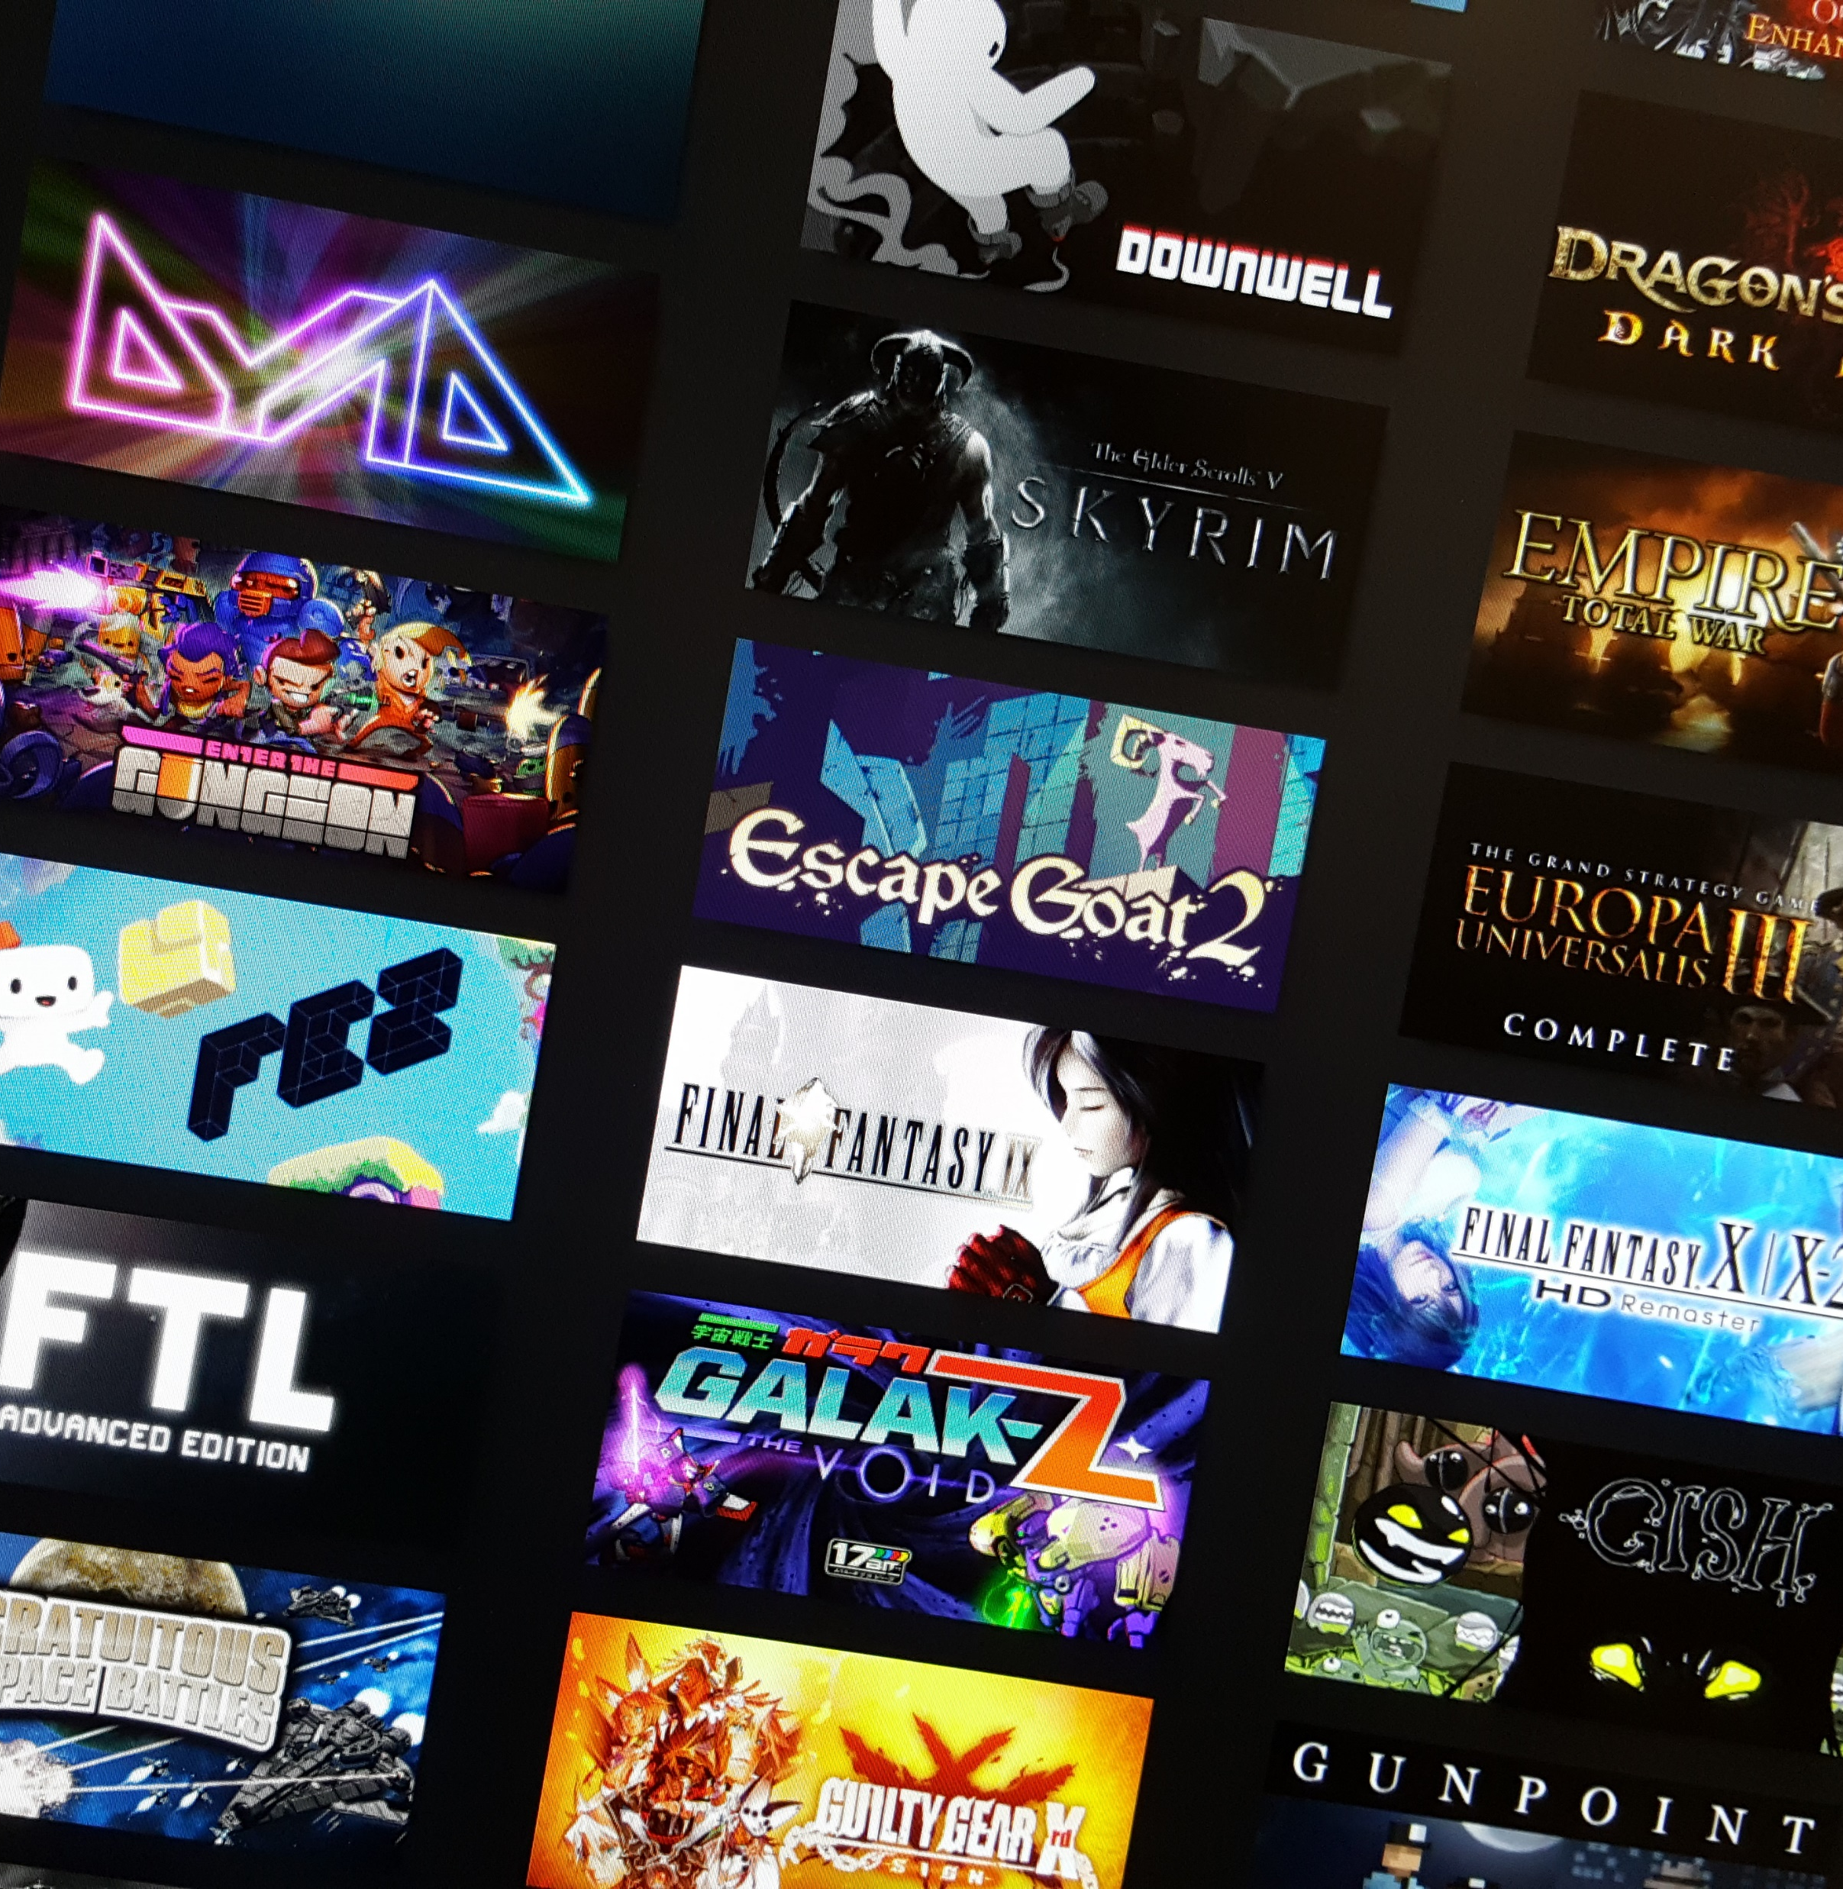

Green Lion Game Store The Green Lion Game Store will be the next new platform for purchasing video games. We will be building a functional, user-friendly, and secure website. Objective Have a responsive web design, Secure Database, and efficient project management

Slide 4
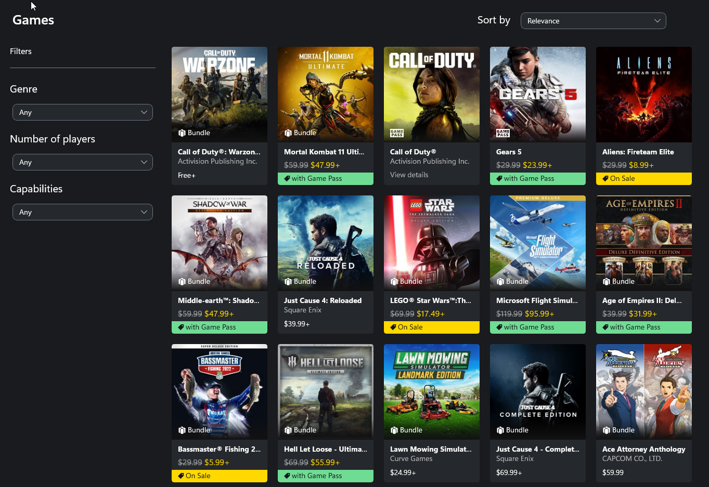
Store Page Concept

Slide 5
Tools and Technologies
Tools
Languages
InfinityFree
FileZilla
GitHub
OnlineGantt
MySQL
HTML
CSS
JavaScript
Notes:
Explain each tool and what we are using it for.

Slide 6
Role Assignments
Kevin- Front end / website development
Aaron- Front end / website development
Stephen- Front end / website development
Deshanno- Back end / database development
Diego- Back end / database development
Notes:
Each member briefly explains their assigned tasks for the next milestone (e.g., front-end development, database design, project management).
Mention that a document has been uploaded to GitHub detailing these tasks, and the link will be provided.

Slide 7
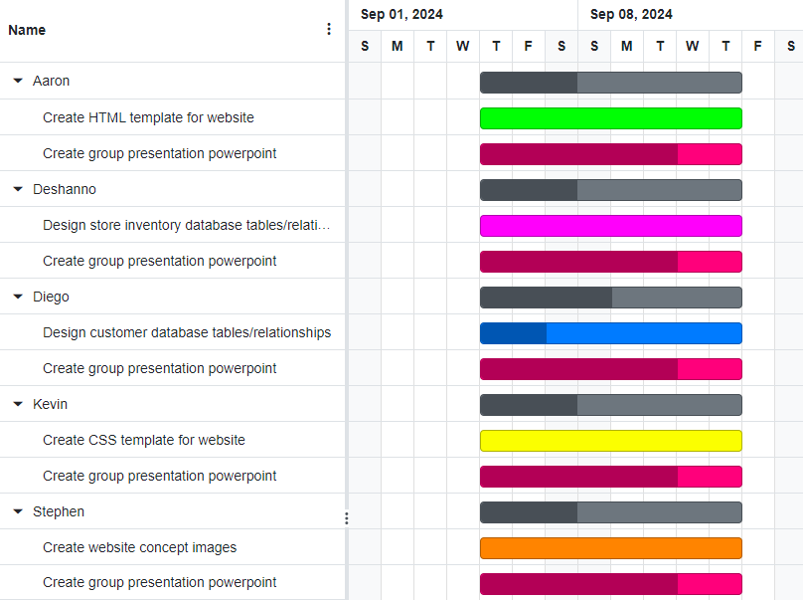
Project Progress
Notes:
Briefly explain the timeline, key milestones, and current progress

Slide 8
Conclusion
The Green Lion Game Store will act like many other gaming stores on the web, like Steam and Epic Games, to provide purchasing options for PC games. Using InfinityFree for hosting, FileZilla for FTP, GitHub as a repository, OnlineGantt for project management, and MySQL for database management, the Green Lion team will create a robust and user-friendly web interface, develop and maintain a strong database, and establish a cohesive project management chart.
Notes:
Add Github link to Comment section in submission page

